Slide 1

How permissive, and for how long.
C
2
Brian Locke MD
Fellow

Slide 2
Case
62 unvaccinated M was transferred from OSH after presenting with COVID-19 and DKA.
He was initially treated with meropenem->CTX, azithromycin, and vancomycin. For COVID-19, he received Remdesevir and Dexamethasone
1 week into his hospitalization at the OSH, he was intubated and transferred to U of U
After transfer, he had the following sequence of chest imaging studies

Slide 10

PCO2?

Slide 11
PCO2?
Cola Line
2.2g CO2 * 1mol/44 g CO2 = 0.05 mol = 50 mmol
12 oz = 355 mL
50 mmol / 0.355 L = 140 mmol/L

Slide 13
Another Patient

Slide 14
What, if anything, should be done about this?
Review of CO2 kinetics
Why does this happen? Dead space fraction in COVID-ARDS
Tolerating Hypercapnia: Pros and Cons
Review of control of ventilation related to hypercapnia and acidosis
Notes:
Management emphasis, not diagnosis

Slide 15
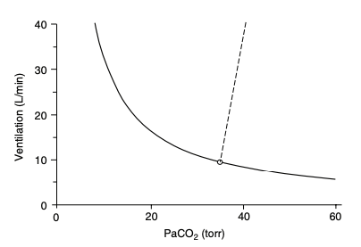
First Principles: What causes high CO2?
PaCO2 = k * VCO2 / VA
PaCO2 = k * VCO2 / VE (1-Vd/Vt)
If you hold VCO2 and Vd/Vt constant, you get the metabolic hyperbola (solid line) which relates PaCO2 to Ve
Notes:
Is this based on Fick?
Tobin comprehensive physiology
Controller system sensitivity can be evaluated by forcing an increase in PaCO2 and measuring a subsequent increase in Ve – straight line, where change in Ve per mmHg paCO2 = sensitivity.
-normal range in healthy adults is 0.5 to 8.0 L/min/mmHg (1.5-5.0 in 80% of subjects) (269) - 269 - Tobin MJ, Gardner WN. Monitoring of the control of ventilation. In: Tobin MJ, editor. Principles and Practice of Intensive Care Monitoring. New York: McGraw-Hill, Inc., 1998, pp. 415-464

Slide 16
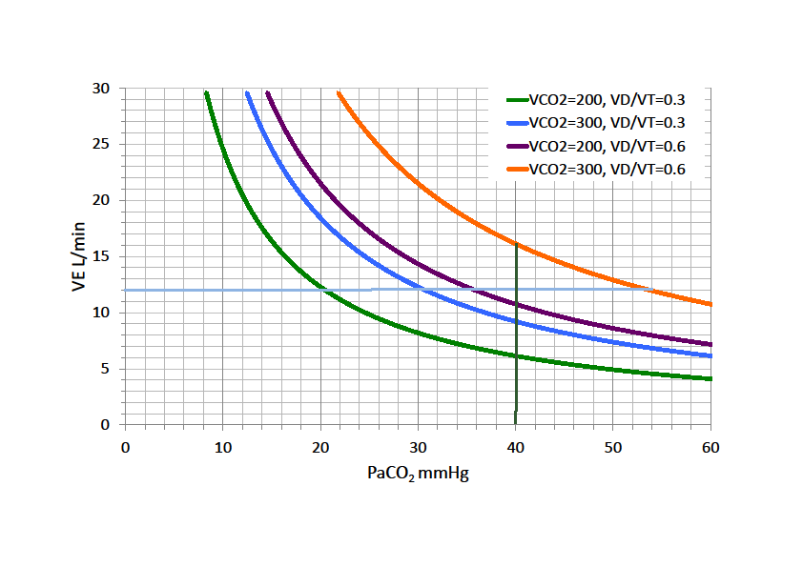
PaCO2 = k * VCO2 / VE (1-Vd/Vt)
VCO2: doesn’t vary all that much in covid
VE: we are often (mostly) in control in this in the situation of COVID ARDS. In health, the body regulates this incredibly tightly.
More on this soon
Vd/Vt: is this uniquely bad in COVID-ARDS versus other ARDS?
Vd/Vt = (PaCO2 - PECO2) / PaCO2

Slide 17
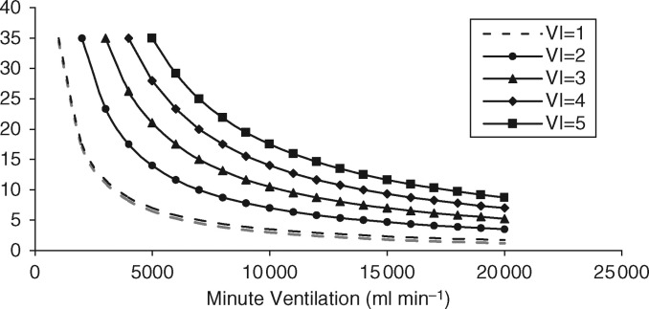
Dead space in ARDS
MIGET studies (10-15cc/kg days): Vd/Vt = ~0.60 in severe ARDS
Estimate using PECO2 (~EtCO2) to PaCO2 ratio (requires blood gasses)
VD/VT = (PaCO2-PECO2)/PaCO2
Ventilatory ratio (VR): [minute ventilation (ml/min) × Pa_{CO2} (mm Hg)]/[predicted body weight × 100 (ml/min) × 37.5 (mm Hg)]
VCO2 estimated based on body size*.
Index of impaired ventilatory efficiency that correlates with Vd/Vt
Notes:
Is VCO2 the same in COVID ARDS as in non-COVID ARDS?
(4), is a simple bedside index of impaired efficiency of ventilation and correlates well with physiological Vd fraction (Vd-to-Vt ratio, Vd/Vt) in patients with ARDS (4–6).
https://www.atsjournals.org/doi/full/10.1164/rccm.202002-0373LE
4.Sinha P, Fauvel NJ, Singh S, Soni N. Ventilatory ratio: a simple bedside measure of ventilation. Br J Anaesth 2009;102:692–697.Google Scholar
5.Sinha P, Fauvel NJ, Singh P, Soni N. Analysis of ventilatory ratio as a novel method to monitor ventilatory adequacy at the bedside. Crit Care 2013;17:R34.Google Scholar
6.Sinha P, Calfee CS, Beitler JR, Soni N, Ho K, Matthay MA, et al. Physiologic analysis and clinical performance of the ventilatory ratio in acute respiratory distress syndrome. Am J Respir Crit Care Med 2019;199:333–341.Google Scholar

Slide 18
What, if anything, should be done about this?
Review of CO2 kinetics
Why does this happen? Dead space fraction in COVID-ARDS
Tolerating Hypercapnia: Pros and Cons
Review of control of ventilation related to hypercapnia and acidosis
Notes:
Management emphasis, not diagnosis

Slide 19
Dead space in ARDS: Is COVID different?
Beloncle et al 2021: n=112 COVID-19 ARDS matched to n=198 non-COVID pulmonary ARDS
Matched on age, SAPS2 score, P:F, PEEP
Found Crs was no different. VR was lower in COVID-19 at day 1 compared to non-COVID, but increased to similar degree by day 7.
Luca Grieco et al 2021: n=30 COVID-19 matched to n=30 non-COVID ARDS
Matched on P:F, FiO2, PEEP, tidal volume
Ventilatory ratio (2.1 [1.7–2.3] vs. 1.6 [1.4–2.1], p = 0.032) slightly higher in COVID-19 group
Conclusion: mixed but underwhelming differences
COVID-19 patients are often otherwise healthy, present with single organ failure
Non-COVID ARDS matched for the degree is likely to either die or be cured (antibiotics). Bias due to Survivorship and illness duration?
Possible COVID-ARDS evolves differently than other lung injury
Notes:
https://ccforum.biomedcentral.com/articles/10.1186/s13054-021-03665-8
https://ccforum.biomedcentral.com/articles/10.1186/s13054-020-03253-2

Slide 20
Deadspace trajectory through ARDS
https://twitter.com/danleisman/status/1468689855370702850?s=11

Slide 21
Why is a normal PaCO2 33ish mmHg (SLC)?
Ventilation is metabolically expensive
work of breathing = 2% of O2 at rest, but increases hugely with exercise or pathology
The same pH can be achieved at any PaCO2 by adjusting the bicarbonate: pH = 6.1 + log [ HCO3 / (0.03 * pCO2) ]
The existence of ‘compensation’ suggests pH is the defended variable
Why doesn’t the body operate with with a PaCO2 of 70? (and an HCO3 of 44 = pH 7.42) This would be metabolically advantageous.
Especially in states where the work (power) of breathing is higher - such as lung disease
PaCO2 = k * VCO2 / VE (1-Vd/Vt)
VE (1-Vd/Vt) = k * VCO2 / PaCO2
Notes:
54 - Cunningham DJC, Robbins PA, Wolff CB. Integration of respiratory responses to changes in alveolar partial pressures of CO2 and O2 and in arterial pH. In: Cherniack NS, Widdicombe JG, editors. Handbook of Physiology, Section 3. The Respiratory System. Volume II: Control of Breathing, part 2, Bethesda, MD: Am Physiol Soc, 1986, pp. 475-528.
Gamblegram = the ion stacked diagrams that would be relevant for showing renal compensation

Slide 22
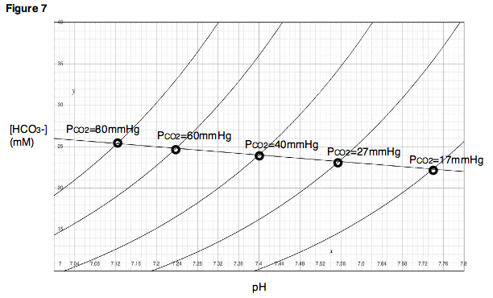
Davenport Diagram: pH = 6.1 + log [ HCO3 / (0.03 * pCO2) ]
Why not live here?
Renal Compensation
Hypoventilation
Notes:
graphical demonstration of the Henderson–Hasselbach relationships
Can do any combination of CO2 and pH by modifying bicarbonate.
“ Normal physiology seems to be designed to defend the pH more robustly than defending the PaCO2 (e.g., respiratory compensation for metabolic acid/base disorders demonstrates that evolution cares more about pH than PaCO2). Enzyme and protein function depends on pH, not PaCO2 – explaining why pH is more important.”

Slide 23
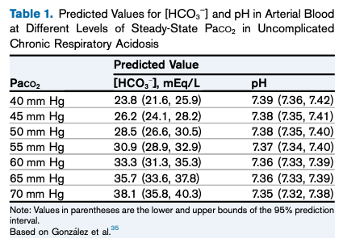
What actually happens in this process:
3-5 days to reach steady state metabolic compensation in dogs; unknown time in humans
Acute: 0.1 mEq/L per 1 mmHg – modified some by pre-existing degree of HCO3. Not dependent on kidney
Chronic: 1960s – 0.35 to 0.4 mEq/L per 1mmHg Co2 increase; 0.48 - 0.51 mEq/L per 1mmHg more recently; depends on renal function.
Summarized in doi: 10.1053/ j.ajkd.2019.05.029
Notes:
The anticipated effect of an NaHCO3 load of 1 mmol per kilogram of body weight is an increase in plasma [HCO3 − ] of w2 mEq/L if bicarbonate space is 50% of body weigh

Slide 24
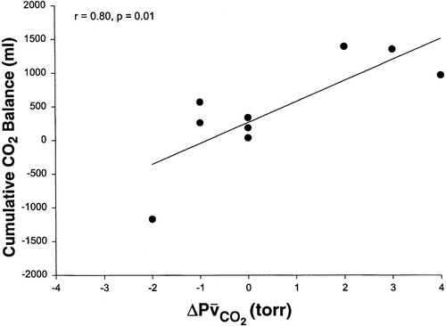
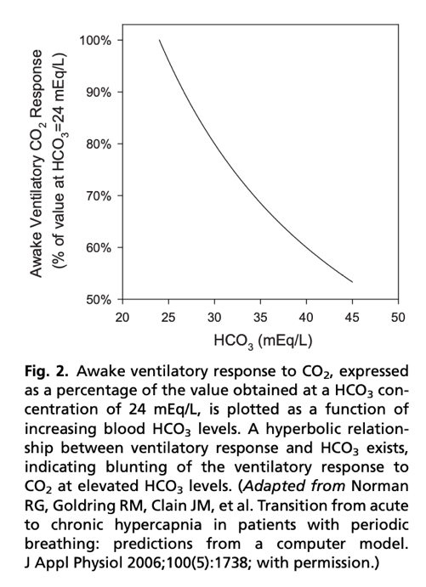
How much CO2 is ‘sequestered’? From https://doi.org/10.1152/jappl.2000.88.1.257
Notes:
Mixed venous CO2
In essence, bicarbonate generation increases the Vd of CO2 (following the creatinine anaology)
Scott’s grand rounds from April (acute breath holds)– all of those kinetics are applicable to the acute change, where there is no bicarbonate buffer.
=➔ free diving, consider bicarbonate supplementation?
From doi:10.1016/j.jsmc.2014.05.014 , summarizing the above study
when CO2 response was abnormally low, a modest rise in awake PCO2 and [HCO3] was seen over multiple days. Similarly, when renal HCO3 excretion rate was lowered to simulate chloride deficiency, the model demonstrated a modest rise in awake PCO2 and [HCO3] over multiple days, even with normal CO2 response. Significantly, the combination of low CO2 response and low renal HCO3 excretion rate produced a synergistic effect on the degree of elevation of PCO2 during wakefulness.

Slide 25
In a world without supplemental oxygen…
PA_{O2} = (P_{atm} – P_{H2O}) * Fi_{O2} – (Pa_{CO2} / RQ) + Fi_{O2} * Pa_{CO2} * (1-RQ)/RQ
(P_{atm} – P_{H2O}) * Fi_{O2} = represents O2 arriving at the alveoli, which becomes saturated with H2O through the airways
Pa_{CO2} / RQ represents the volume of O2 in the alveoli removed into the blood
Fi_{O2} * Pa_{CO2} * (1-RQ)/RQ represents the passive flow that must occur to maintain steady state when RQ =/= 1, because every O₂ molecule leaving the alveoli is NOT replaced by 1 molecule of CO₂.
Hypoventilation causes hypoxemia;
evolutionarily advantageous to have an oxygenation buffer?
severe hypercapnia is only possible with supplemental oxygen (Dalton’s Law)
Notes:
Dalton’s Law
Explanation of the alveolar gas equation.
https://journals.physiology.org/doi/full/10.1152/advan.00064.2019

Slide 26
PA_{O2} = (P_{atm} – P_{H2O}) * Fi_{O2} – (Pa_{CO2} / RQ) + Fi_{O2} * Pa_{CO2} * (1-RQ)/RQ
Normal A-a gradient? 4 + (0.25 * Age)
Critical PAO2 = paO2 + (Normal A-a gradient)
Notes:
Hypercapnia is largely iatrogenic: without supplemental oxygen, people with hypercapnia wouldn’t persist – especially if they had concomitant lung disease.
This also makes sense why these people might be so frail and prone to readmission… as your PaCO2 goes up, your buffer goes down. In fact, that’s probably why we’re evolved to hyperventilate with altitude. – called referred to as “ventilatory acclimatization” (92).
Lastly: PaCO2 increases exponentially as VE decreases linearly (think of CO2 clearance and how GFR is much more different th
Note: from Dempsey JAP 2020 Pulmonary Overnuilt?
“[in sharp contrast
to these maladaptive responses to exercise in the sojourner,
trained or untrained residents of high altitude have acquired a
markedly reduced chemosensitivity plus an enhanced pulmonary
diffusion capacity that allows them to protect their arterial
PO2 during exercise via a narrowed A-aDO2 without excessive
hyperventilation and dyspnea (23, 34, 117)];”
23 https://www.jci.org/articles/view/107497
34 https://www.sciencedirect.com/science/article/abs/pii/0034568772900527?via%3Dihub
117 https://journals.physiology.org/doi/full/10.1152/ajpregu.00725.2003

Slide 27
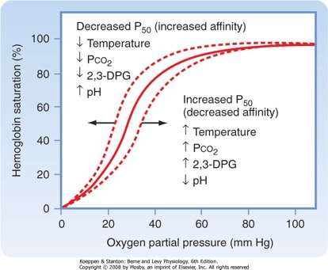
When we control the alveolar gasses…
At 100% FiO2, hypercapnia will almost never cause hypoxemia
PA_{O2} = (P_{atm} – P_{H2O}) * Fi_{O2} – (Pa_{CO2} / RQ) + Fi_{O2} * Pa_{CO2} * (1-RQ)/RQ
PaCO2 = 40: PA_{O2} = (647 – 47) * 1 – (40 / 0.8) + 1 * 40 * (1-.8)/.8 = 556 mmHg
PaCO2 = 120: PA_{O2} = (647 – 47) * 1 – (120 / 0.8) + 1 * 120 * (1-.8)/.8 = 534 mmHg
True effect might be different:
Moves O2-Dissociation curve to the right (could cause hypoxia)
Worsened V/Q matching (vasoconstriction in high VA zones)
Notes:
That apneic oxygenation is a thing tells you that you don’t you can correct hypoventilation hypoxemia with O2. (though apnia =/= no ventilation in the case of HFNC)

Slide 28
What, if anything, should be done about this?
Review of CO2 kinetics
Why does this happen? Dead space fraction in COVID-ARDS
Tolerating Hypercapnia: Pros and Cons
Review of control of ventilation related to hypercapnia and acidosis
Notes:
Management emphasis, not diagnosis

Slide 29
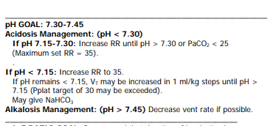
Argument for allowing hypercapnia
Could you ventilate at <6 cc/kg if you allow PaCO2 to increase?
k * VCO2 / 40 mmHg vs k * VCO2 /120 mmHg => 3x less VA; without the (probable) evolutionary reason we don’t do this (O2)
Direct Evidence: (Permissive Hypercapnia)
LTVV ARDS trials allow pH < 7.30 if RR 35+ or Pplat 25-30
What is attributable to the PHC, and what is the LTVV? Is PHC beneficial outside these indications? What about hypercapnia without acidosis?

Slide 30
Is it the hypercapnia, or the severity of ARDS that leads to mortality?
Nin et al, 2017: 1998-2010, 1899 patients with ARDS
Maximum PaCO2 within 48h <30, 30-9, 40-9, 50-9, 60-9, 70+ mmHg
Multivariable Logistic regression: age, SAPS2, P/F, PEEP, RR, Acidosis, vent stg
Causal? Many other pertinent confounders (baseline CO2, lung disease, other management)
Notes:
https://pubmed.ncbi.nlm.nih.gov/28108768/ indep association w mortality
All these are retrospective, weak evidence for/against causality

Slide 31
Is it the hypercapnia, or the severity of ARDS that leads to mortality?
Muthu et al 2017: n=415 with ARDS 2001-2016 at a single center
Multivariable logistic regression: APACHE2, pH, severity of ARDS
PaCO2 not independently associated with mortality (but pH is)
Notes:
https://link.springer.com/article/10.1007%2Fs00134-017-4794-0 no association
All these are retrospective, weak evidence for/against causality

Slide 32
Notes:
Elevated PaCO2 was significantly associated with acute cor pulmonale and PaCO2≥ 60 mmHg was the only independent factor associated with acute cor pulmonale 60.
0. Lheritier G, Legras A, Caille A, et al. Prevalence and prognostic value of acute cor pulmonale and patent foramen ovale in ventilated patients with early acute respiratory distress syndrome: a multicenter study. Intensive Care Med. 2013; 39(10):1734-1742.
Acute cor pulmonale was found in 22% of the cohort and severe acute cor pulmonale (defined as RVEDA/LVEDA >1) was found in 7.2 % of patients and was an independent predictor of mortality 67.
67. Mekontso Dessap A, Boissier F, Charron C, et al. Acute cor pulmonale during protective ventilation for acute respiratory distress syndrome: prevalence, predictors, and clinical impact. Intensive Care Med. 2016; 42(5):862-870
69: 69. Tiruvoipati R, Pilcher D, Buscher H, Botha J, Bailey M. Effects of Hypercapnia and Hypercapnic Acidosis on Hospital Mortality in Mechanically Ventilated Patients. Crit Care Med. 2017; 45(7):e649-e656.
(table 2). Interestingly both patients with compensated hypercapnia, and hypercapnic acidosis had higher mortality rates.

Slide 33
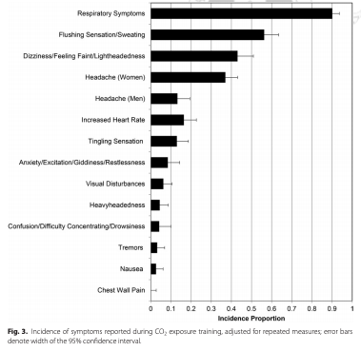
CO2 ‘Narcosis’?
Less lipid soluble than N2;
CNS effects mediated by changes in intracellular pH and cerebral blood flow
Decreased LOC occurs when CO2 rises above 90-120 mmHg (Nunn’s and Lambs)
Likely contributes to encephalopathy in ICU patients
Adaptation almost certainly occurs
Healthy astronauts inhaling 8% CO2 (60 mmHg) experience =>
Notes:
Except for helium and probably neon, all gases that can be breathed have a narcotic effect, although widely varying in degree.^{[2][3]} The effect is consistently greater for gases with a higher lipid solubility, and although the mechanism of this phenomenon is still not fully clear, there is good evidence that the two properties are mechanistically related

Slide 34
What, if anything, should be done about this?
Review of CO2 kinetics
Why does this happen? Dead space fraction in COVID-ARDS
Tolerating Hypercapnia: Pros and Cons
Review of control of ventilation related to hypercapnia and acidosis
Notes:
Management emphasis, not diagnosis

Slide 35
Sedation vacation:.
Will this patient feel more, less, or the same degree of dyspnea compared to a hypothetical patient with normal acid/base status?

Slide 36
Ventilator Dyssynchrony
Anxiolysis, Analgesia, and ‘Respirolysis’ are only weakly related when assessed by P 0.1
https://journals.lww.com/ccmjournal/fulltext/2021/12000/managing_patient_ventilator_dyssynchrony_.18.aspx
https://journals.lww.com/ccmjournal/fulltext/2021/12000/discordance_between_respiratory_drive_and_sedation.9.aspx

Slide 37
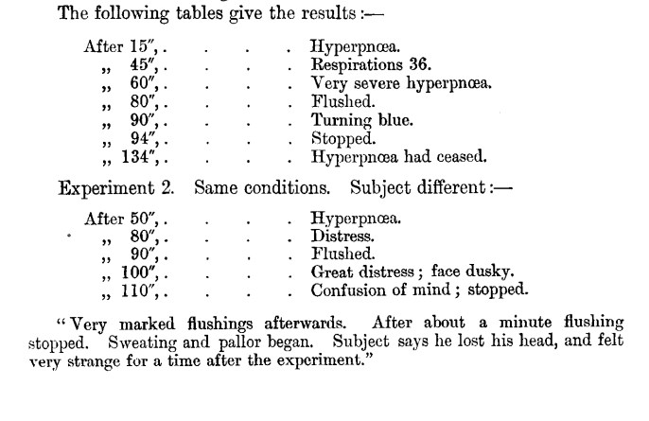
Haldane, Submarines, and Space Shuttles
What happens if you keep increasing FiCO2?
FiCO2 0 to 1.5%: VE increases, kidneys compensate, PaCO2 stable.
FICO2 1.5 to 3-6%: Partial renal compensation, VE increases to defend CO2
Bicarbonate excretion from kidneys = 0, max renal effort (1963 - Operation Hideout).
FiCO2 3-6%+: somehow, the respiratory control system realizes it would be too costly to defend a given CO2 and PaCO2 levels are allowed to rise
This occurs before MVV
’Comroe’s Law’
Notes:
NOTE: still not clear to me what method of ‘long-term’ control there is to keep the set point from creeping to 40 to 50 to 60 etc -→ Ventilatory Facilitation
At 1.5% CO2 inspired, kidneys able to normalize pH. Though paCO2 level increases
At 3.0% and 6%, kidneys are only able to partially compensate, even after 30 days
Bicarbonate excretion in urine was undetectable for 7 days after returning to room air -> suggesting maximal retention was ongoing to coordinate.
Until the advent of nuclear submarines, atmospheric regulation limited duration of submersibles (e.g. Diesel uses O2 combustion).
Now, can keep at 0.5 to 1.5% CO2 with molecular sieves (think Styrofoam that holds the CO2, then can be flushed outside the vessels)
For example, due to limitations in CO₂ scrubbing technology, astronauts on the ISS are chronically exposed to 0.005–0.008 (0.5–0.8%), ∼10–20 times higher than earth, with allowable transient (∼1 h) increases in as high as 0.02 (2%; Law et al. 2014).
21 sailors breathed normal atmosphere for 9 days, then 42 days of 1.5% (FiCO2 0.015; normal is 0.0004)
Alveolar CO2 increased, renal compensation occurred by 24 days. Ventilation changes?
Burgraff et al 2018 (https://pubmed.ncbi.nlm.nih.gov/30211447/) – reduction in cognitive performance throughout the 30 days of hypercapnia (6% FICO2), PaCO2 to 55, higher ventilation – transient increase in chemoreflex, then return to normal
From Burgraff:
Figure 13. Proposed mechanism(s) accounting for the shift in ventilatory set-point during 30 days of exposure to 6% InCO2 The shift in ventilatory set-point may involve either presynaptic and/or postsynaptic mechanisms. A, the proposed presynaptic mechanism involving both tonic and phasic chemosensitive input into a respiratory motor neuron. Under eucapnic conditions, the primary input onto the respiratory motor neuron is from tonic presynaptic chemosensitive input. During acute hypercapnia, input from the tonic presynaptic input is elevated, alongside increased input from the phasically chemosensitive presynaptic neuron. During chronic hypercapnia, the phasically active chemosensitive input is silenced, whereas elevated input from the tonic chemosensitive presynaptic neuron is maintained. B, the alternative postsynaptic mechanism accounting for a shift in the ventilatory set-point during chronic hypercapnia. In this schematic, there is the presence of both tonically active and phasically active receptors upon the postsynaptic membrane of a respiratory motor neuron. Under eucapnic conditions, activity from the presynaptic chemosensitive neuron activates the tonically active receptors upon the postsynaptic membrane of the respiratory motor neuron. However, during acute hypercapnia, there is both elevated activity of the tonically active receptors, and contribution from the phasically active receptors. During chronic hypercapnia, the phasically active receptors are silenced, whereas activity from the tonically active receptors is maintained at an elevated level.

Slide 38
Drive to breath in 1 minute:
4 sources:
Chemical drive – related to changes in arterial PO2 (NOT oxygen saturation), arterial and brain PCO2 and pH. Mediated by central and peripheral chemoreceptors.
Metabolic drive – related to metabolic rate and mediated by unknown mechanisms (e.g. how the Ve increases in CPET before blood gases change)
Wakefulness drive – disappears during sleep & anesthesia, a minor PaCO2 drop in presence of normoxia produces a central apnea
Voluntary / Supratentorial factors (anxiety hyperventilation, anticipation)
Notes:
Wakefulness drive to breath ensures that you continue to ventilate some even when PaCO2 below the set point during the day, but this goes away when you sleep (hence the possibility of central apneas - which don’t occur when awake - duh)
86. Fink B, Hanks E, Ngai S, Papper E. Central regulation of respiration during anesthesia and wakefulness. Ann N Y Acad Sci U S A 109: 892-900, 1963.
According to https://www.cell.com/neuron/pdf/S0896-6273(15)00676-5.pdf – metabolic drive may be mediated by reflexes from muscle groups, though unclear which neural circuits involved.

Slide 39
Ventilatory Control
Central Chemoreceptors | Ventral surface of medulla | Responds to H+ in ECF of CNS – this equilibrates with CO2 in blood (no charge) more than pH in blood. CSF HCO3 lessens response. No O2 sensing. Slower response
Peripheral Chemoreceptors | Carotid and Aortic bodies. Aortic body contributes to sympathetic and cardiovascular response | Respond (rapidly) to PaO2, PaCO2, and pH
Experiments injecting acids into CSF of animals leads to increase in VA
When PaCO2 and pH differ? (DKA) Mediated by metabolic drive to breath and peripheral chemoreceptor.
Notes:
“The CB senses PCO2 and H1 in arterial blood, contributing to 20–30% of the reflex regulation of CO2-H1 levels in response to hypercapnic acidosis, while the central chemoreceptors are responsible for the other 70–80%”(presumably, this is in healthy individuals at sea level)
However, the CB chemosensory discharge also increased in response to isohydric hypercapnia (304 Iturriaga R, Mokashi A, Lahiri S. Dynamics of carotid body response in vitro in the presence of CO2-HCO3 . Role of carbonic anhydrase J Appl Physiol (1985) 75: 1587–1594, 1993. doi:10.1152/jappl.1993. 75.4.1587.) – thought related to drop in intracellular pH (even with normal blood pH) due to carbonic anhydrase
(from https://journals-physiology-org.ezproxy.lib.utah.edu/doi/pdf/10.1152/physrev.00039.2019).
Taken together, the evidence points to two major mechanisms underlying hypoxiai nduced tachycardia: 1) selective inhibition of CB chemoreceptor-induced cardiac parasympathetic activity by the lung inflation reflex and 2) an aortic chemoreceptor induced increase in cardiac sympathetic nerve activity and/ or inhibition of parasympathetic activity.
***does the impact of carotid body mediated complications vary with elevation?

Slide 40
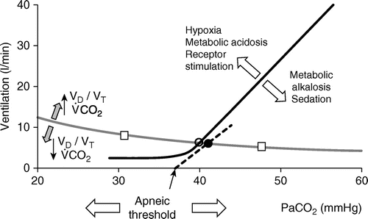
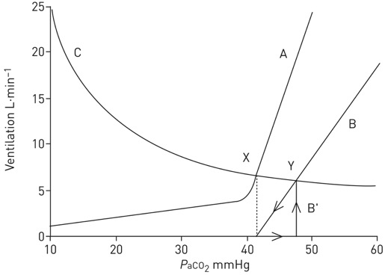
Sensitivity of the controller system to CO2:
The PCO2/Ventilation Response ‘Curve’: straight/dashed line.
The amount that the respiratory system will respond to an increase in PaCO2
slope = change in Ve / change in PaCO2
Steeper slope = more sensitive, flatter = less sensitive
Notes:
Normal range 0.5-8.0 L/min/mmHg (wide range)
80% of subjects have a response between 1.5 and 5 L/min/mmHg (118)
118. Irsigler GB. Carbon dioxide response lines in young adults: The limits of the normal response. Am Rev Respir Dis 114: 529-536, 1976
313. Younes M, Georgopoulos D. Control of breathing relevant to mechanical ventilation. In: Marini JJ, Slutsky AS, editors. Physiological Basis of Ventilator Support. New York: Marcel Dekker, Inc., 1998, pp. 1-73.
(306) – Younes M. Mechanisms of ventilatory failure. Current Pulmonology 14: 243-292, 1993a.

Slide 41
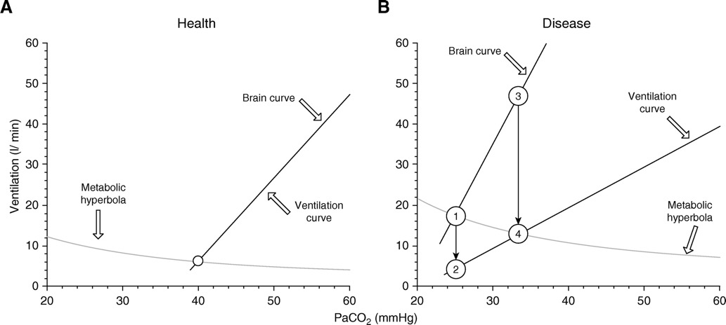
Might HCO3 buffering.. reduce dyspnea?
Brain curve (line): Ve that would occur if the respiratory system could do what the brain wants
Ventilation curve (line): Actual Ve
Dissociation of brain and ventilation curves -> dyspnea
Notes:
HCO3 would decrease the brain curve by decreasing the chemical drive to breath (buffering in the CSF)

Slide 42
Returning to our patient:
Do you maximize VE within the parameters of ARMA to slowly correct? (RR 35, Plat 25-30)
Do you give acetazolamide?
Do you tolerate (or even encourage) hypercapnia to continue to minimize ventilator trauma and hope that eventually dead space improves?

Slide 43
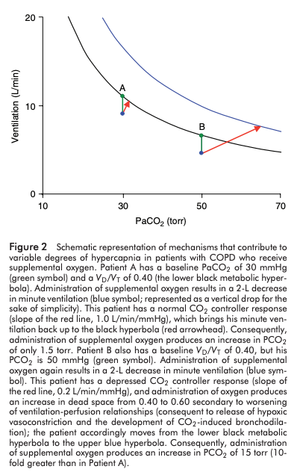
The lung: an ultra-kidney for volatile acids.
‘CO2 Clearance’: Analagous to creatinine kinetics
Urine volume : VE (exhaled volume)
[U_cr] : FExhaled CO2
Serum creatinine : PaCO2
GFR : CO
Implication:
Further down on the ventilation axis, right on the PaCO2 axis, or R shifted the curve (increased VCO2 or Vd/Vt)
Larger the change in CO2 that will occur from a given change in Ve
Analogy: sCr of 6 is not much different than 5; PaCO2 70 not much different than 80
Yet, impacts of CO2 on hypoxemia, CNS, CV system, and drive to breathe may be linear.
Notes:
RESEARCH QUESTION: how often are acute hypercapneic ABGs at least partially compensated? (or known to be via prior bicarbonates)
'Kinetics' will be the same, but faster. Implication, similar to sCr 5 not being much diff than 6, 70 not much different than 80 as PaCO2
The above mentioned changes in the respiratory control system of OHS patients make them more vulnerable to acute deterioration of their ventilatory systems when faced with new insults, such as chest infection or mild worsening of cardiac function. This makes OHS patients more susceptible to acute ventilatory failure [126,154].
126. BaHamman A: Acute ventilatory failure complicating obesity hypoventilation: update on a ‘critical care syndrome’. Curr Opin Pulm Med 2010, 16:543–551.
154. Rabec C, de Lucas RP, Veale D: Respiratory complications of obesity. Arch Bronchoneumol 2011, 47(5):252–261.

Slide 44
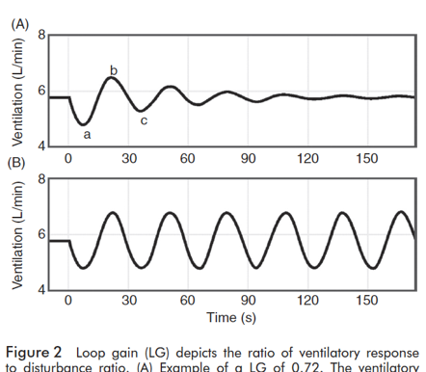
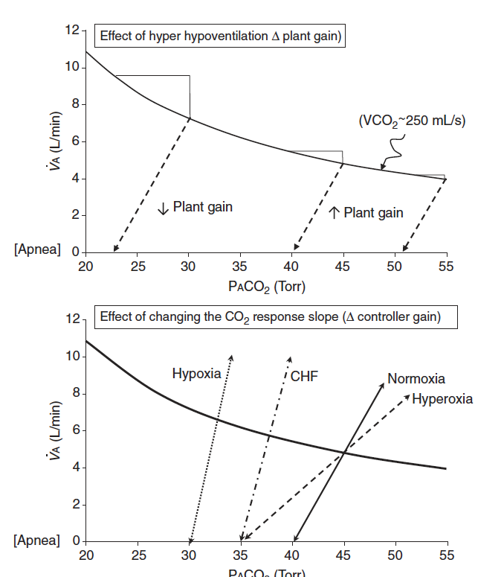
Does the PaCO2 ‘set-point’ change?
For example, in OHS:
Loop gain terminology primarily describes tendency toward stability of ventilation. ‘Gain’ of the feedback loop.
Controller gain: ventilatory response to PO2 and PCO2 )
Plant gain: changes in pulm capillary blood PO2 and PCO2 in response to changes in vent
Mixing gain: effective circulation time – time which cap blood changes are sensed by controller
Many changes are known to influence chemoreflex sensitivity
Ventillatory long-term facilitation is the process that should keep things on track
Ventilatory long-term facilitation is the term for adaptation to chronic stimulus (ie. sustained hypercapnia should increase loop gain to re-establish a baseline, and if this goes wrong you get a ‘wandering baseline’)
Notes:
Although ventilatory LTF has not been reported as such in OSA patients, when compared to age, sex and BMI matched non-OSA participants, untreated OSA patients exhibit a reduced P_{ET}CO₂, reduced CO₂ reserve and increased CO₂ sensitivity below eupnea, which reflects the expression of ventilatory LTF and ventilatory feedback (47, 55). Following CPAP treatment P_{ET}CO₂ and the CO₂ reserve increased in the OSA patients, further supporting the possible presence of ventilatory LTF in untreated OSA patients (47).
https://www.frontiersin.org/articles/10.3389/fneur.2018.00896/full
47 - Salloum A, Rowley JA, Mateika JH, Chowdhuri S, Omran Q, Badr MS. Increased propensity for central apnea in patients with obstructive sleep apnea: effect of nasal continuous positive airway pressure. Am J Respir Crit Care Med. (2010) 181:189–93. doi: 10.1164/rccm.200810-1658OC
55 - Chowdhuri S, Shanidze I, Pierchala L, Belen D, Mateika JH, Badr MS. Effect of episodic hypoxia on the susceptibility to hypocapnic central apnea during NREM sleep. J Appl Physiol. (2010) 108:369–77. doi: 10.1152/japplphysiol.00308.2009
Not clear that it really does ’reset’ so much as never able to compensate (by the modeling done in the next set of slides).
Perhaps this is different with Opiates, oxygen, etc.

Slide 45
Acetazolamide?
No effect in this RCT – OHS and COPD
https://pubmed.ncbi.nlm.nih.gov/28286047/

Slide 46
Post-script: meta-analysis
https://link.springer.com/article/10.1007/s00134-022-06640-1
Found conflicting results
Positive results from protective ventilation
Negative from effects on pulmonary vascular dysfxn

Slide 47
https://annalsofintensivecare.springeropen.com/articles/10.1186/s13613-022-01006-8
COPD – ECCO2R
Faster normalization of blood gasses (CO2, pH) -> resolution of dyspnea.

Slide 48
Editorial for https://link.springer.com/article/10.1007/s00134-022-06640-1
https://doi.org/10.1007/s00134-022-06696-z
They object to “induced” vs “permissive” hypercapnia done in the study
Notes:
In biological systems, theCO2 molecule seems to be relatively nontoxic as longas its hydration does not lead to an acute accumulationof excess amounts of hydrogen ions [2] Paramount to homeostatic functions, pH is kept at narrow range by shifts in HCO3−/CO2 balance, with acute adjustments relying on CO2 removal regulation (through alveolar ventilation).

